Slide 2
SMART SAFE
Smart Safe Security System

Slide 3
JEIS ROBOTICS

Slide 4
Rishad Babu
Arun k
Shibil
Sadhique Ali
Shanid
Ashwin Krishna C
Vyshak MS
Jishal
Arun jyothish k

Slide 5
Features included
Finger Print--- Pin Lock--- Deny Alert--- Threat Image Capture--- Iot Unlock --- Oled Display--- Speech Synthesis ---time log

Slide 6
EXPLAINING WORKING !!!

Slide 7
RASPBERRY PI
The Raspberry Pi is a low cost, credit-card sized computer that plugs into a computer monitor or TV,
and uses a standard keyboard and mouse. It is a capable little device that enables people of all ages to explore computing,
and to learn how to program in languages like Scratch and Python

Slide 8
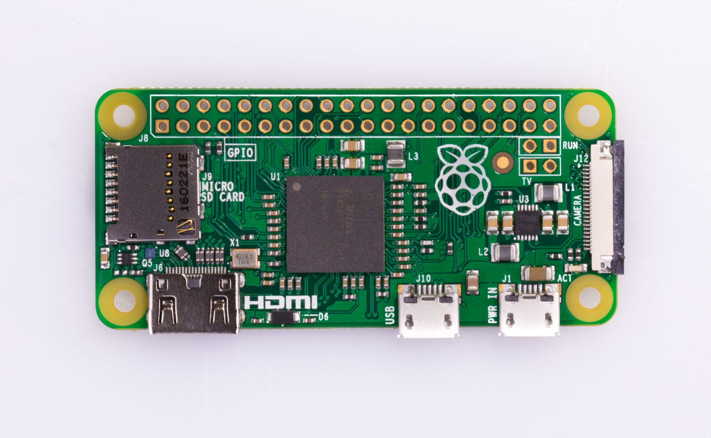

Slide 9
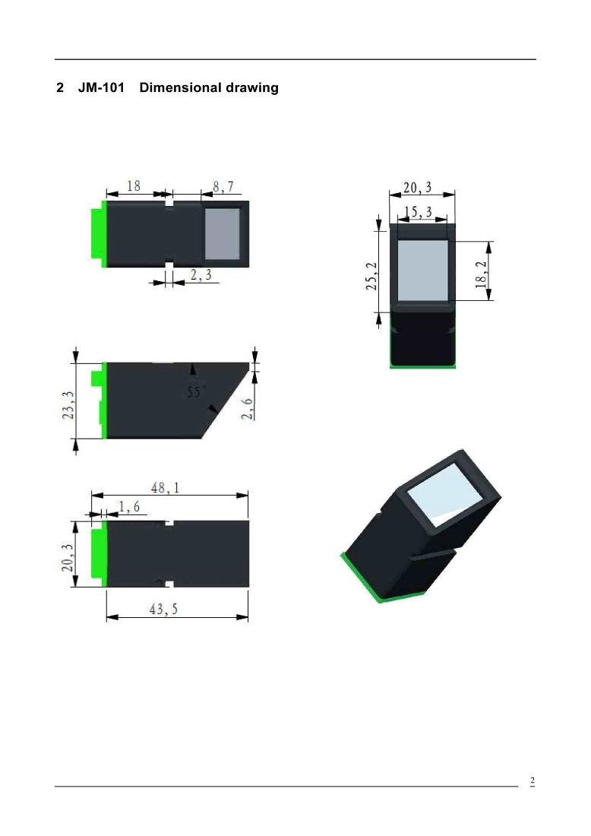
FINGERPRINT SENSOR
JM-101 fingerprint module low power consumption, high reliability, fast recognition
Optical sensor

Slide 10
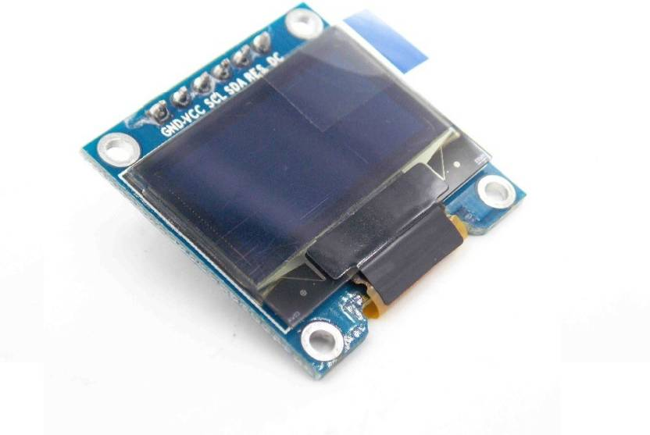
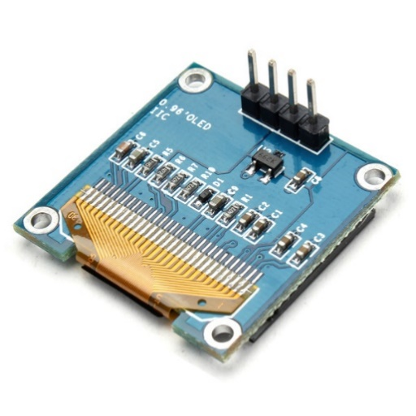
Oled Display
SSD1306 i2c 128*64
Low power comparatively cheap

Slide 11
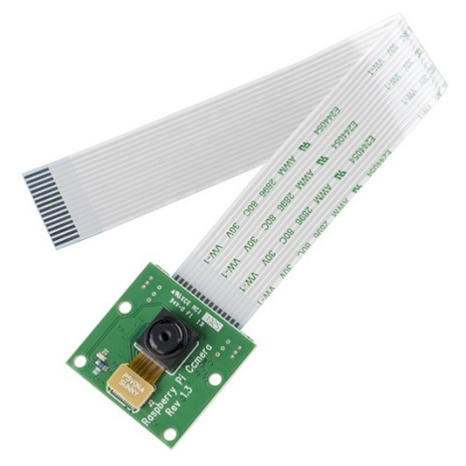
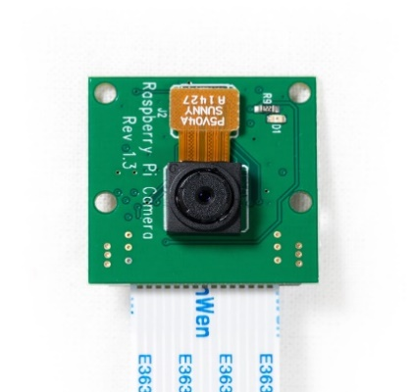
RASPBERRY PI CAMERA V1.3
5MP

Slide 12
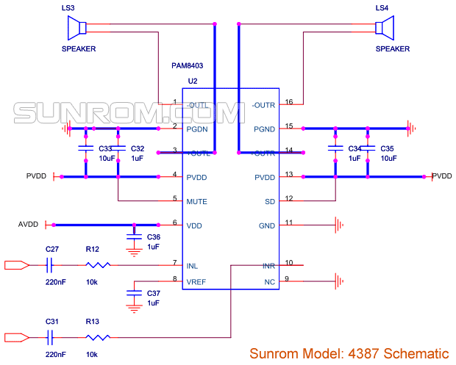
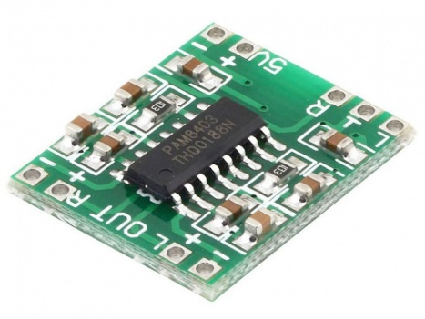
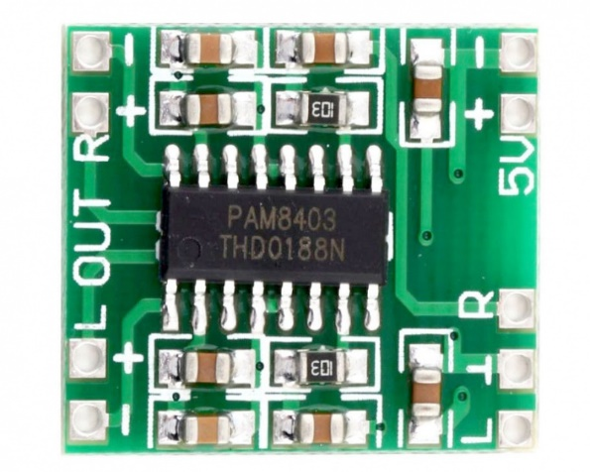
PAM 8403 AMPLIFIER MODULE
LOW COST SIMPLE 5V 2CHANNEL AMP MODULE

Slide 13
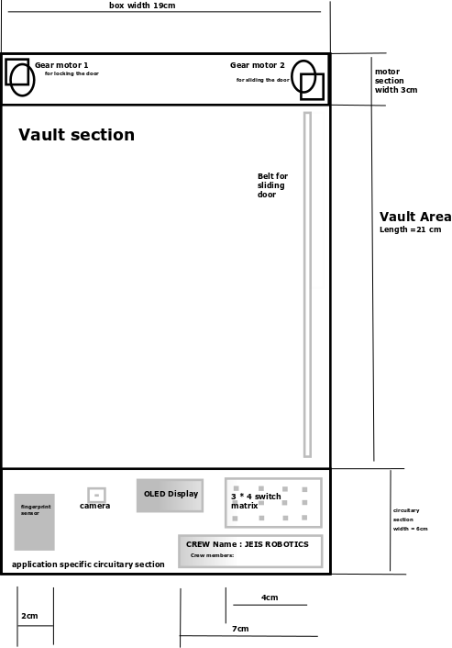
CONCEPT :

Slide 14
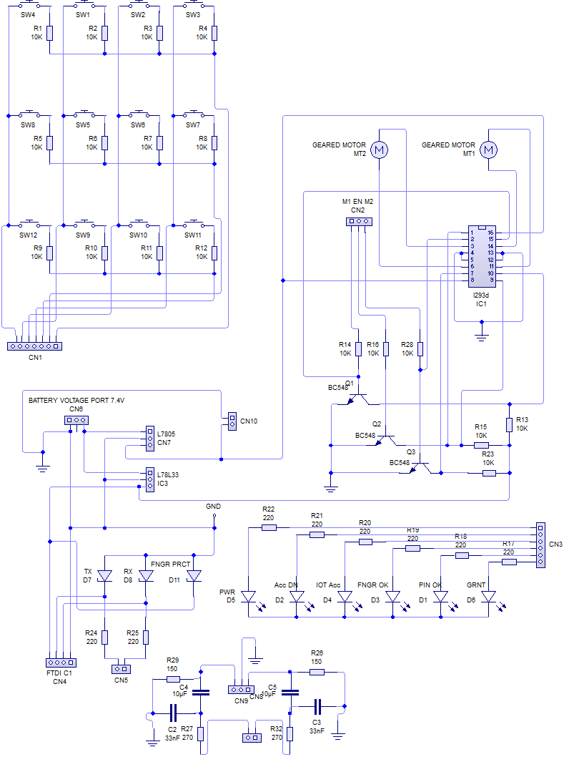
APPLICATION
SPECIFIC CIRCUITRY

Slide 15
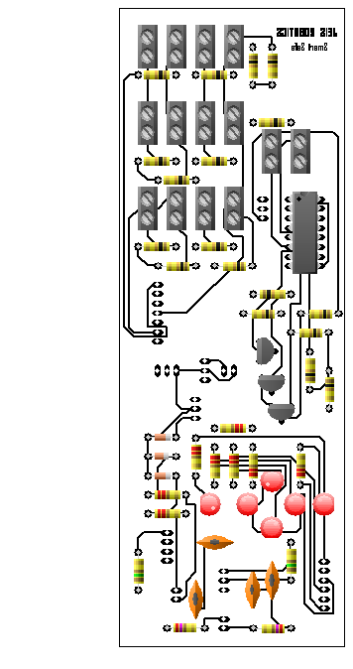
PCB DESIGN
COMPONENTS+ART WORK

Slide 16
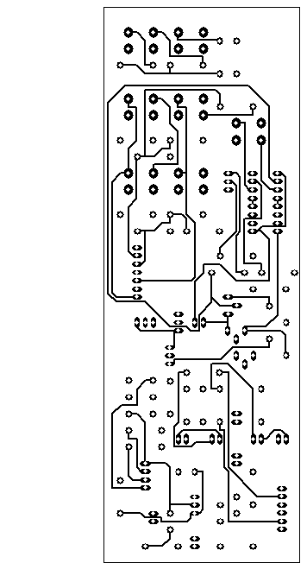
PCB DESIGN
PCB COMPONENT SIDE :

Slide 17
PCB DESIGN
PCB BOTTOM SIDE :

Slide 18

? ? ?
THANKS FOR YOUR PATIENTS

